Slide 1
Dalia Abdallah
Presenter Name

Slide 2
Agenda
Topic one : Fixed Point Iteration Method.
Topic two : Algorithm of Fixed Point Iteration Method.
Topic three : example
Topic four : Advantages and Disadvantages of Fixed point method .

Slide 3


Introduction
The fixed point iteration method one of the open methods that use initial point to find the root of equation . It uses the concept of a fixed point in a repeated manner to compute the solution of non-linear equation. A fixed point is a point in the domain of a function g such that g(x) = x. In the fixed point iteration method, the given function f(x) = 0 is algebraically converted in the form of g(x) = x.

Slide 4
Topic one
Fixed Point Iteration Method

Slide 5
Fixed Point Iteration Method :
Suppose we have an equation f(x) = 0, for which we have to find the solution. The equation can be expressed as x = g(x). Choose g(x) such that |g’(x)| < 1 at x = x_{o} where x_{o} is some initial guess called fixed point iterative scheme. Then the iterative method is applied by successive approximations given by x_{i+1} = g(x_{i} )
i= 0,1,2,… ,that is, x₁ = g(x_{o}), x₂ = g(x₁) and so on.

Slide 6
Topic Two
Algorithm of Fixed Point Iteration Method

Slide 7
Algorithm of fixed point iteration method to find the root of f (x) = 0 :
Input:
-The function f(x),
-The interval [a, b] where the root lies in ,which f(a) < 0 and f(b)>0.
-The absolute error (eps).
Output:
-The root (x),
-The value of f(x)
-Numbers of iterations (n)

Slide 8
1-Choose the initial value x_{o} for the iterative method. One way to choose x_{o} is, take x_{o} as the average of a and b. 2- Express the given equation, in the form x = g(x) such that |g’(x)| < 1 at x = x_{o}. If there more than one possibility of g(x), choose the g(x) which has the minimum value of g’(x) at x = x_{o} 3- Use an initial guess of the root x_{i} to estimate the new value of the root x_{i + 1}using the formula: x_{i+1} = g(x_{i} ) . 4- Go to step 3 until | x_{i+1} - x_{i}|<= and/or | g(x_{i+1} ) |<=

Slide 9
Topic Three
Fixed point example

Slide 10
Example:
Given f(x) = x – cos(x) , eps = 10^-4 , x_{o} = 1
_{Solution}
Rarrange to f(x) in the form x = g(x) and verify that
|g’(x)| < 1 at x = x_{o} such that :
x = x+cos(x) /2
Estimate the new values of the root by using this formula:
x_{i+1} = x_{i} + cos(x_{i}) / 2

Slide 11
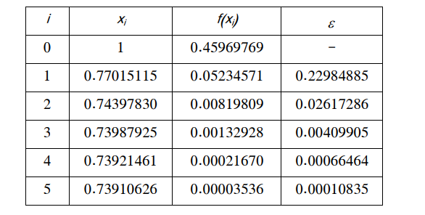
- we note that the value of f(x)~=0, and the value of eps reached to 10^-4 - the values of x are converging.

Slide 12
Topic Four
Advantages and Disadvantages of Fixed point method.

Slide 13
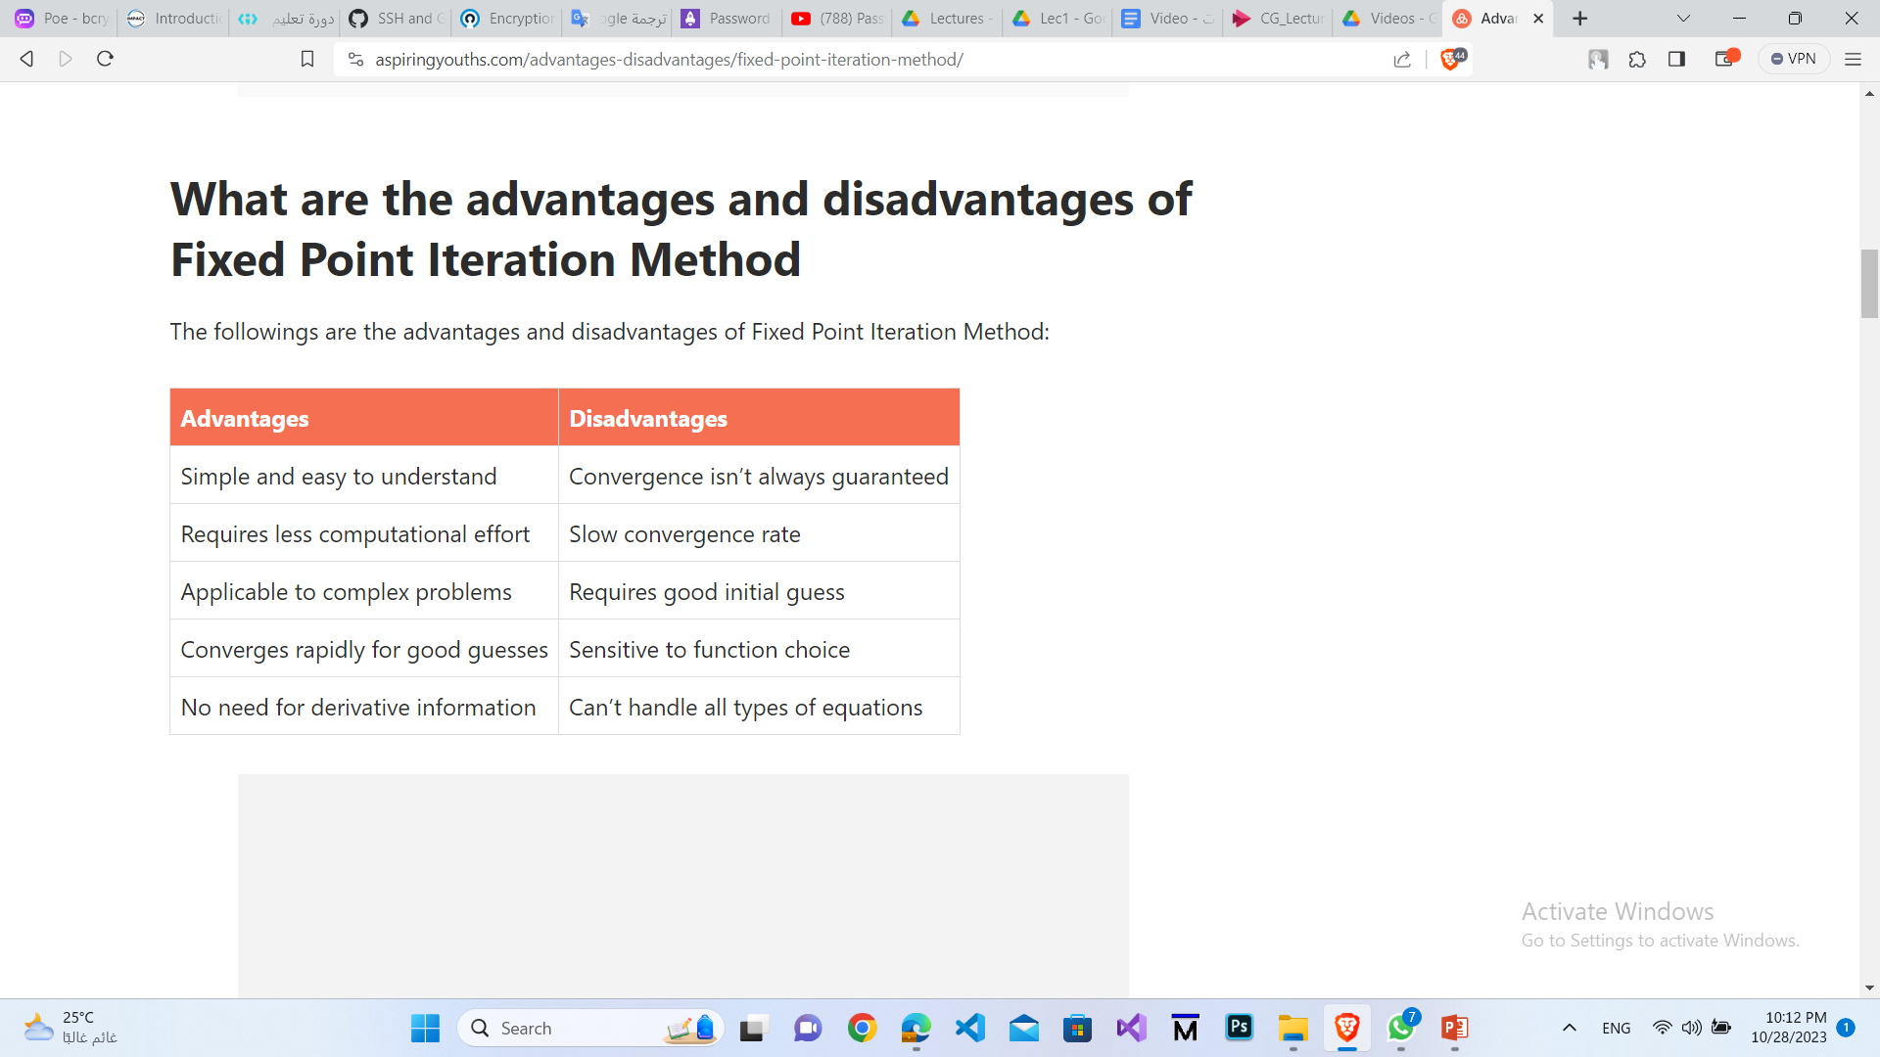
Advantages and Disadvantages of Fixed point method:

